Slide 1
Summary 10/10 Filip Krasniqi, Jocelyne Elias and Jérémie Leguay
October 10, 2019

Slide 2
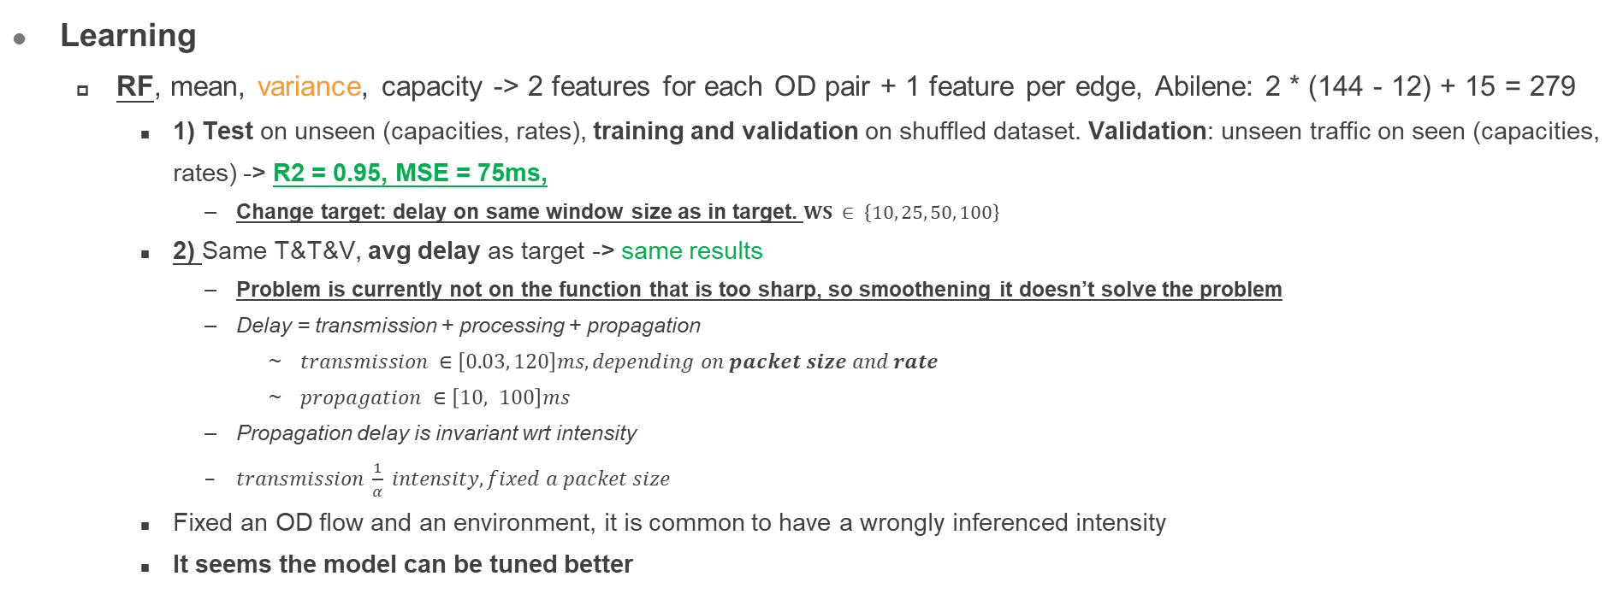
Main points
Learning
RF, mean, variance, capacity -> 2 features for each OD pair + 1 feature per edge, Abilene: 2 * (144 - 12) + 15 = 279
1) Test on unseen (capacities, rates), training and validation on shuffled dataset. Validation: unseen traffic on seen (capacities, rates) -> R2 = 0.95, MSE = 75ms,
Change target: delay on same window size as in target. $WS ∈ \left\{10, 25, 50, 100\right\}$
2) Same T&T&V, avg delay as target -> same results
Problem is currently not on the function that is too sharp, so smoothening it doesn’t solve the problem
Delay = transmission + processing + propagation
$transmission ∈\left[0.03, 120\right]ms, depending on packet size and rate$
$propagation ∈\left[10, 100\right]ms$
Propagation delay is invariant wrt intensity
$transmission \frac{1}{α} intensity, fixed a packet size$
Fixed an OD flow and an environment, it is common to have a wrongly inferenced intensity
It seems the model can be tuned better

